Slide 1
Building Flows to Manage Content and Approvals
Notes:
This modules focuses on using Microsoft Flow to update, manage and transform content in SharePoint Online and OneDrive for Business. The module demonstrates how to build a scheduled flow to enumerate the items in a SharePoint list to clean up and validate the data entered by business users. Students will learn build flows that upload documents and images to SharePoint Online and OneDrive for Business and to convert document content between common file formats such as JSON, XML, HTML and CSV. The module demonstrates building flows to automate the generation of Word documents and PDF files using the using the Word Online connector. This module examines the support in Microsoft Flow for automating an approval process using the Start an Approval action. Students will learn how to build flows to automate an approval process including document approval in SharePoint Online.

Slide 2
Agenda
Converting and Reshaping Data
Uploading Photos to SharePoint
Automating Approval Processes
Integrating Flow with Microsoft Forms
Handling Runtime Errors
Understanding Parallel Execution

Slide 3
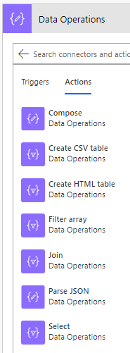
Actions with Data Operations
Compose
Used to parse together text, HTML, JSON, etcs.
Create CSV Table
Used to export data files with CSV format
Create HTML Table
Used to create HTML tables for use in email messages
Filter Array
Filter the contents of an existing array
Join
Parse email address array into single string
Parse JSON
Parse JSON returned from HTTP call into an object
Select
Remap the columns in an array

Slide 4
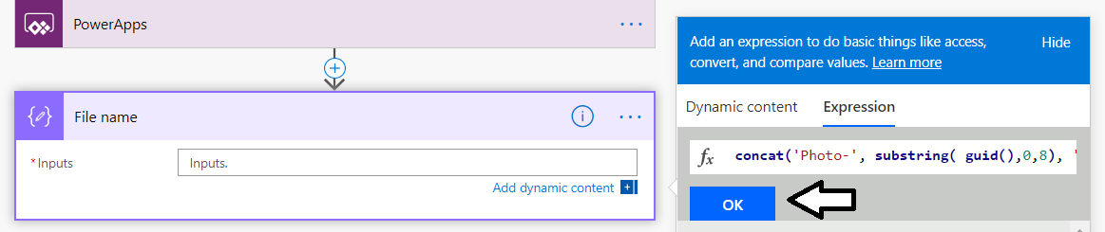
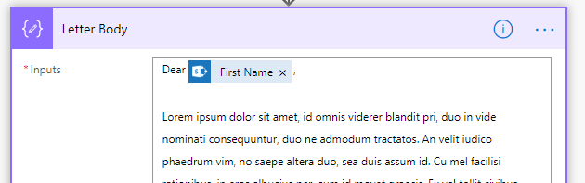
Making Flows Maintainable with Compose
Compose actions used to simplify flow building
Separates parsing content into its own named action
Makes flows easier to read and understand
Example 1: use Compose step to create a file name
Example 2: use compose step to generate content for letter

Slide 5
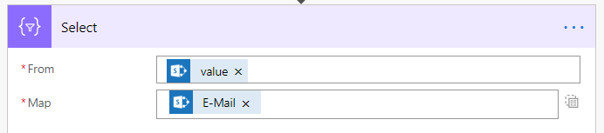
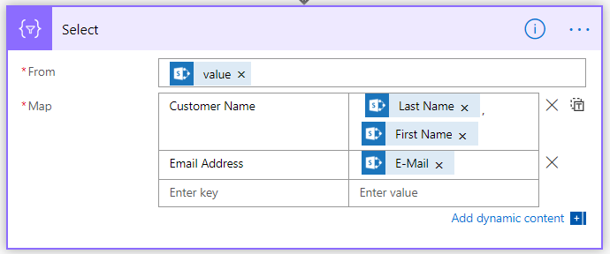
Transforming Arrays using a Select Action
The Select action configured to Text mode or Key-Value mode
Text mode used to create a simple array
Example: use Text mode to create an array of email addresses
Key-Value mode allows you to remap columns from table or list
Example use Key-Value mode to remap columns from Customers list
Use this button to switch between modes

Slide 6
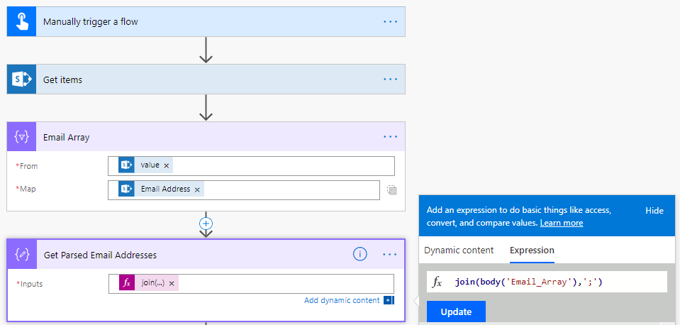
Convert Array of Email Addresses to String
Steps to create a semicolon-delimited list of emails
Use Get Items action to get SharePoint Customers list
Use Select action to create array of email addresses
Use Compose action to build string from array of email addresses
This string can be used in To field of Send an Email action

Slide 7
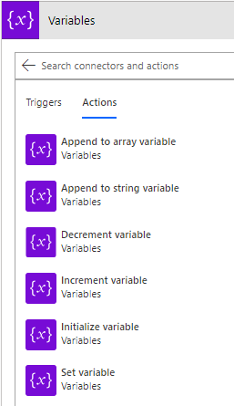
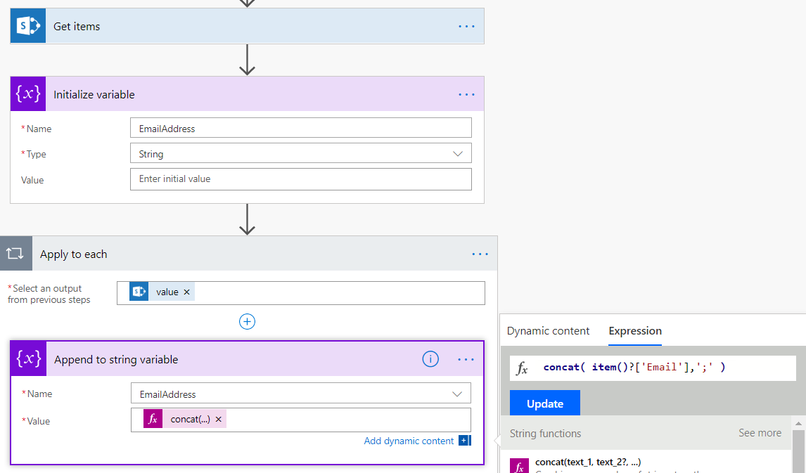
Tracking State using Variables
Variables used to track state during flow lifetime
Initialize Variable action used to create variable instance
Other variable actions uses to update variable values
By default, variable value persisted for lifetime of flow
Variables can be initialized inside Scope action to reduce lifetime

Slide 8
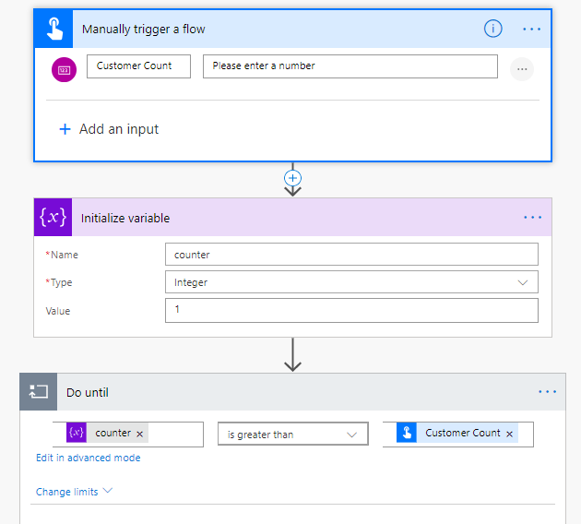
Do Until Action with Counter Variable
Using a variable to control looping in Do until action
Initialize integer variable before Do until action to act as counter
Do until action condition checks variable value
Do until action body requires action to increment variable value

Slide 9
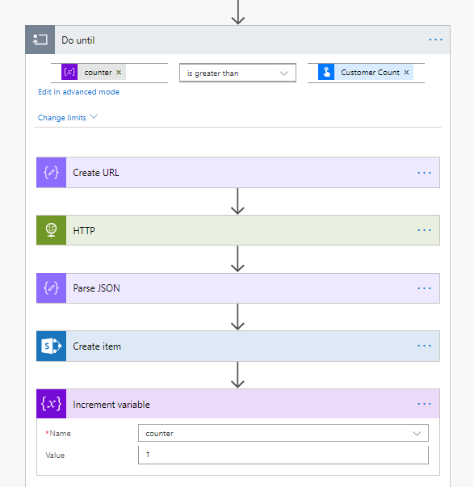
Executing Operations inside Do Until Loop
Implementation of Do until action body
Increment variable action used to change variable value

Slide 10
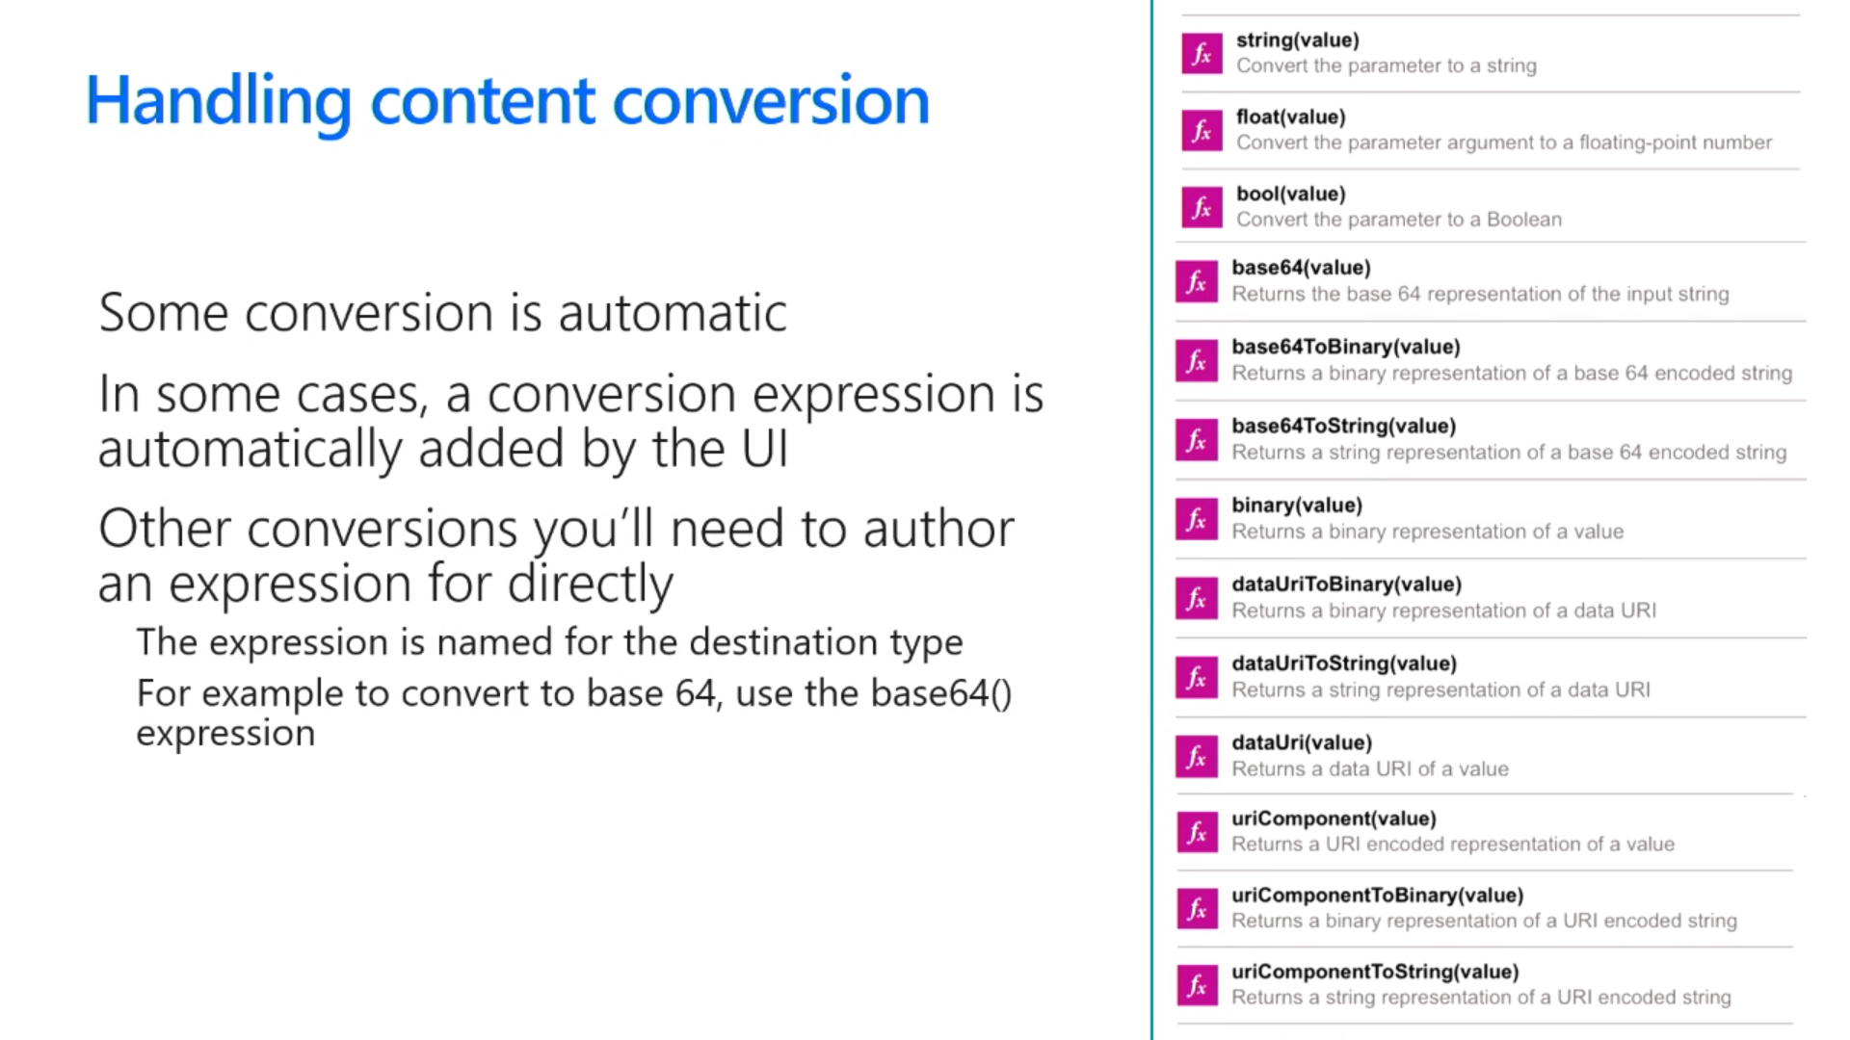
Handling Type Conversion
Some conversion is automatic
Sometimes conversions are performed for you
In other cases, you must explicitly convert between types

Slide 11
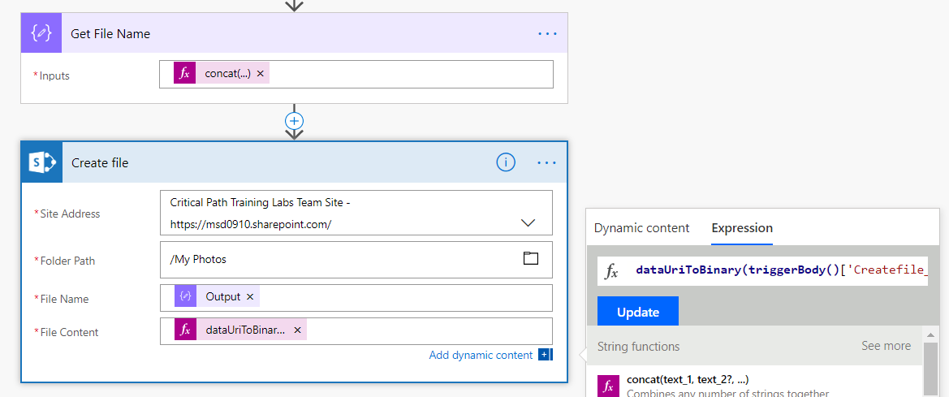
dataUriToBinary()
PowerApps photos require conversion
Allows you to upload phots to SharePoint
Accomplished using dataUriToBinary() function
dataUriToBinary(triggerBody()['Createfile_FileContent'])

Slide 12
Agenda
Converting and Reshaping Data
Uploading Photos to SharePoint
Automating Approval Processes
Integrating Flow with Microsoft Forms
Handling Runtime Errors
Understanding Parallel Execution

Slide 13
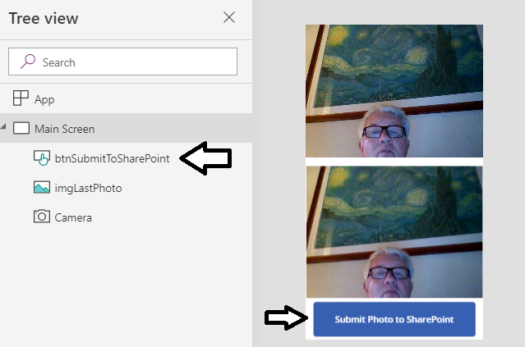
Creating a Canvas App to Upload Photos
Begin by creating a blank canvas app
Add a Camera control
Add an Image control to display camera's last photo
Add a button control to trigger a flow to upload photo

Slide 14
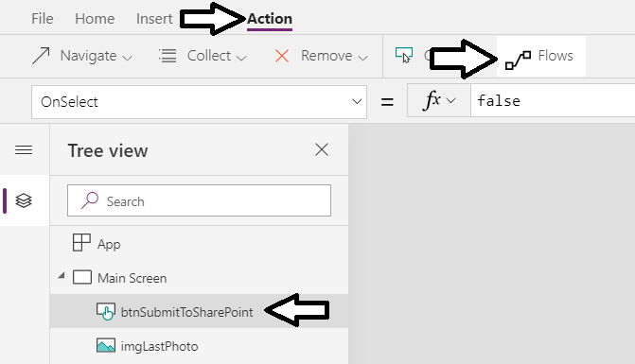
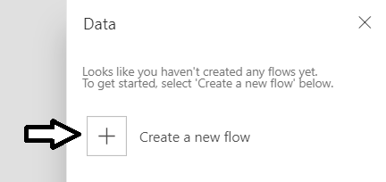
Creating a Flow with a PowerApps Trigger
Create a new flow from the Canvas App editor
Select the button which should trigger the flow
Click Flows button in Action tab to display the Data pane
Click the Create a new flow button
The new flow automatically created with PowerApps button trigger

Slide 15
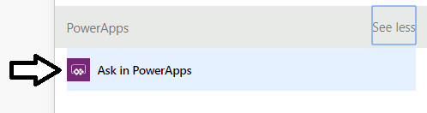
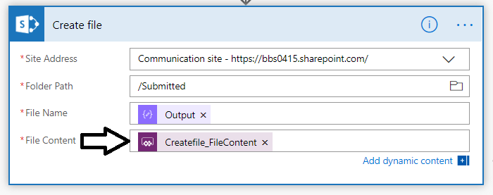
Adding Parameters with Ask In PowerApps
PowerApps trigger provides Ask in PowerApps parameter
Clicking Ask in PowerApps automatically creates new parameter
New parameters used to pass data from canvas app to flow

Slide 16
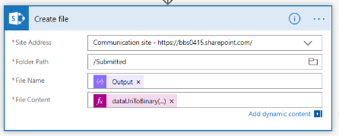
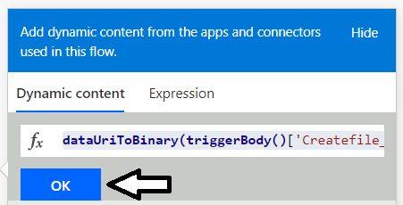
Converting Photos to Binary Format
Camera control image not compatible with SharePoint
Camera control photo image based on Data Uri format
SharePoint document library expects files in binary format
You must convert photos using dataUriToBinary function

Slide 17
Using a Flow to Upload a Photo to a SharePoint Document Library

Slide 18
Agenda
Converting and Reshaping Data
Uploading Photos to SharePoint
Automating Approval Processes
Integrating Flow with Microsoft Forms
Handling Runtime Errors
Understanding Parallel Execution

Slide 19
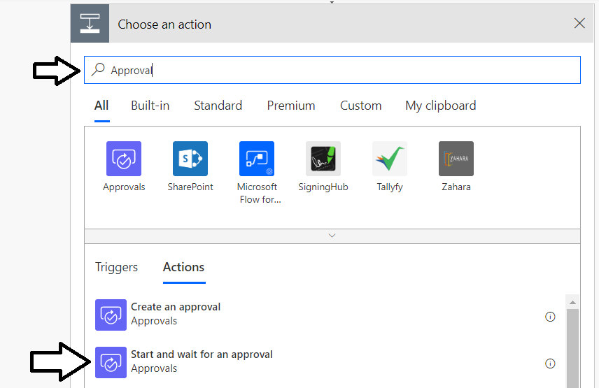
Add the Start an Approval Action
An Approval process is added as an action
Select the Approvals action named Start an approval

Slide 20
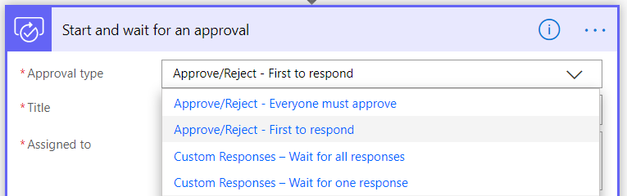
Approval Types
There are several types of approvals
Approve/Reject – Everyone must approve
Approve/Reject – First to respond
Custom Responses – Wait for all responses
Custom Responses – Wait for one response

Slide 21
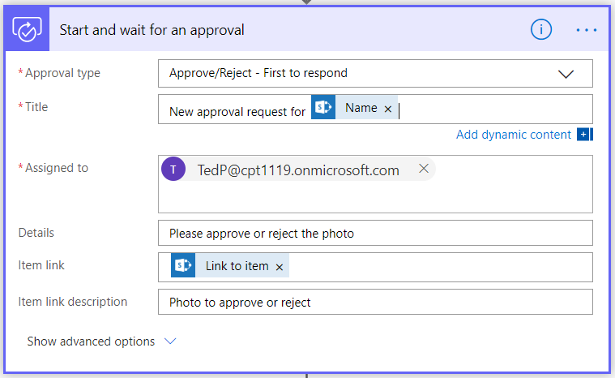
Building Out The Start an Approval Action
You provide data which is sent to approver

Slide 22
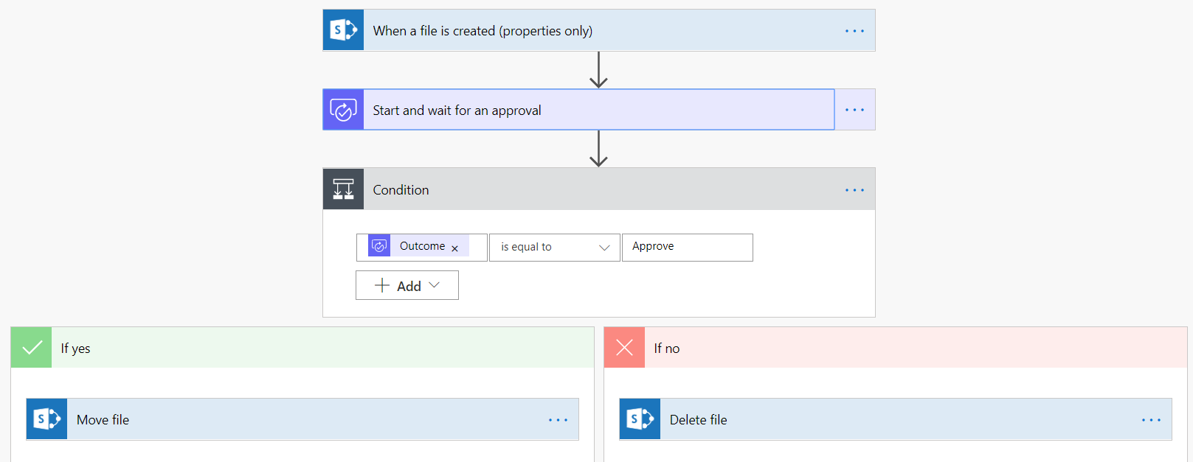
Responding to the Approval Response
Start an Approval action followed by a condition
Allows flow to determine if approval was accepted or rejected
Condition provides If yes and If no branches for both outcomes

Slide 23
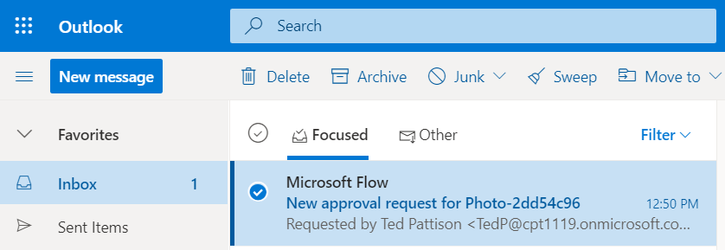
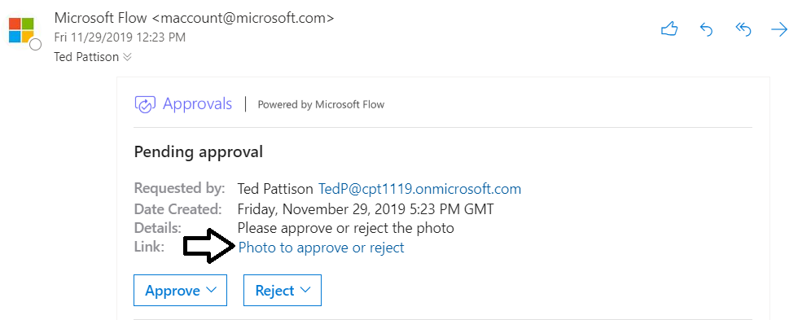
Sending Email Notification to an Approver
The flow sends notification email to the approver
Flow execution currently paused inside Start an Approval action
Email allows approver to approve or reject approval request
Email should also allow approver to see item for approval

Slide 24

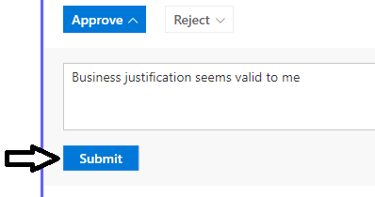
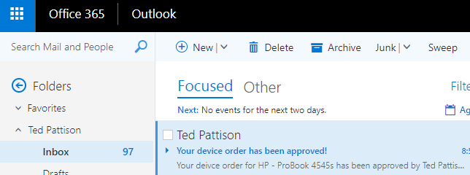
Approving an Approval Request
Notification email provides button to approve or reject request
Approver can enter comment and submit approval (or rejection)
Approval or rejection unblocks flow which continue down appropriate branch
Approval response determines whether to send approval email or rejection email

Slide 25
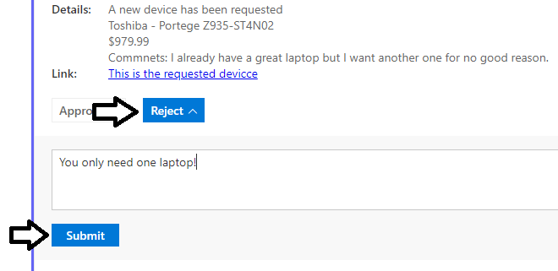
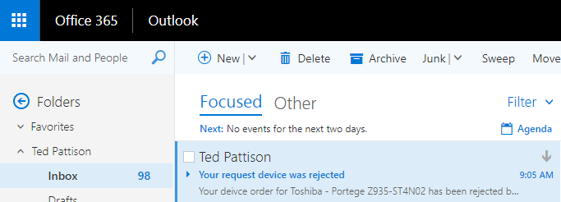
Rejecting an Approval Request
In the case of a rejected request…
Approval flow sends a notification about rejection

Slide 26
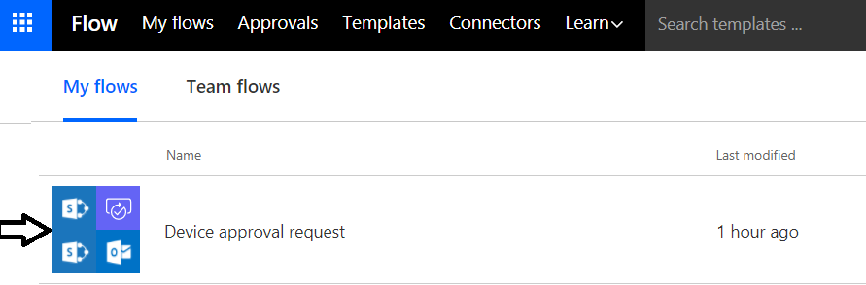
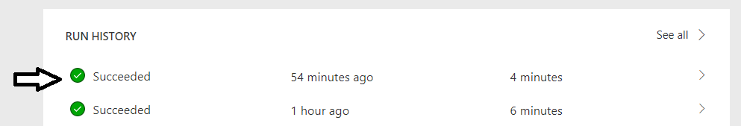
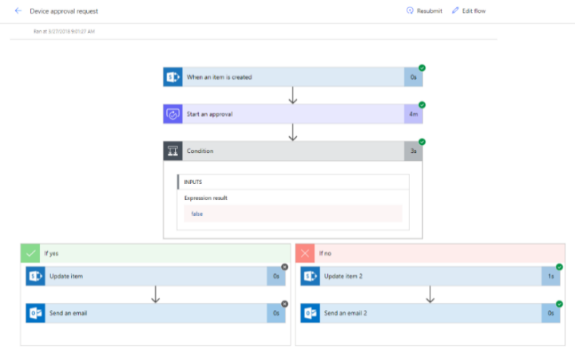
Run History
Flow tracks run history of flow that have started
Click on a flow to see its RUN HISTORY list
RUN HISTORY list has entry for each flow that has started
Drilling into flow run history shows execution path and data

Slide 27
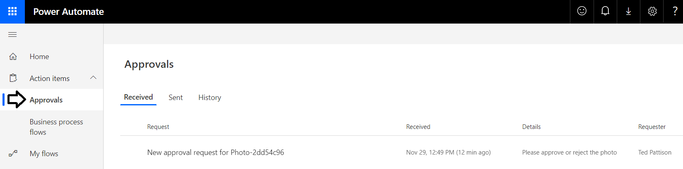
Approvals Center
Microsoft Flow provides Approvals Center
Provides alternative to email for approve/reject processing
Accessible through browser
Provides monitoring of completed approvals and pending approvals

Slide 28
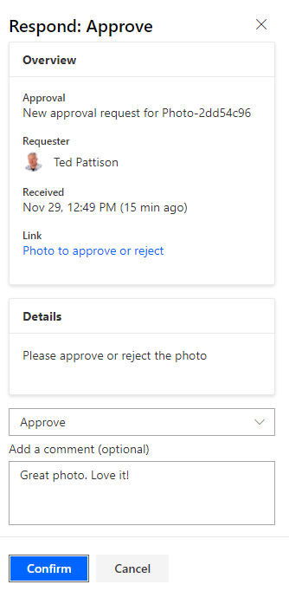
Examining Received Requests
Approvers can see list of all their approval requests
Approver can approve or reject approval request

Slide 29
Agenda
Converting and Reshaping Data
Uploading Photos to SharePoint
Automating Approval Processes
Integrating Flow with Microsoft Forms
Handling Runtime Errors
Understanding Parallel Execution

Slide 30
Creating a Flow to Process Forms Created using Microsoft Forms

Slide 31
Agenda
Converting and Reshaping Data
Uploading Photos to SharePoint
Automating Approval Processes
Integrating Flow with Microsoft Forms
Handling Runtime Errors
Understanding Parallel Execution

Slide 32
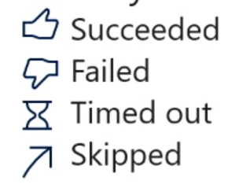
Normal action execution
Standard behavior of a flow
Action steps execute in sequential order
Flow terminates if error occurs (failure or timeout)
After flow runs, every action left in 1 of 4 possible states

Slide 33
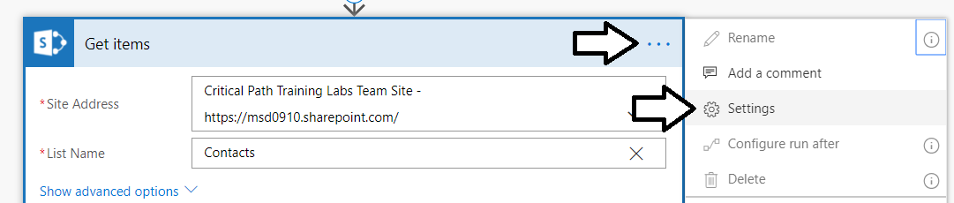
Action Settings
Settings let you configure
Async Actions
Timeouts
Retry Policy
Sequential Behavior
And more!

Slide 34
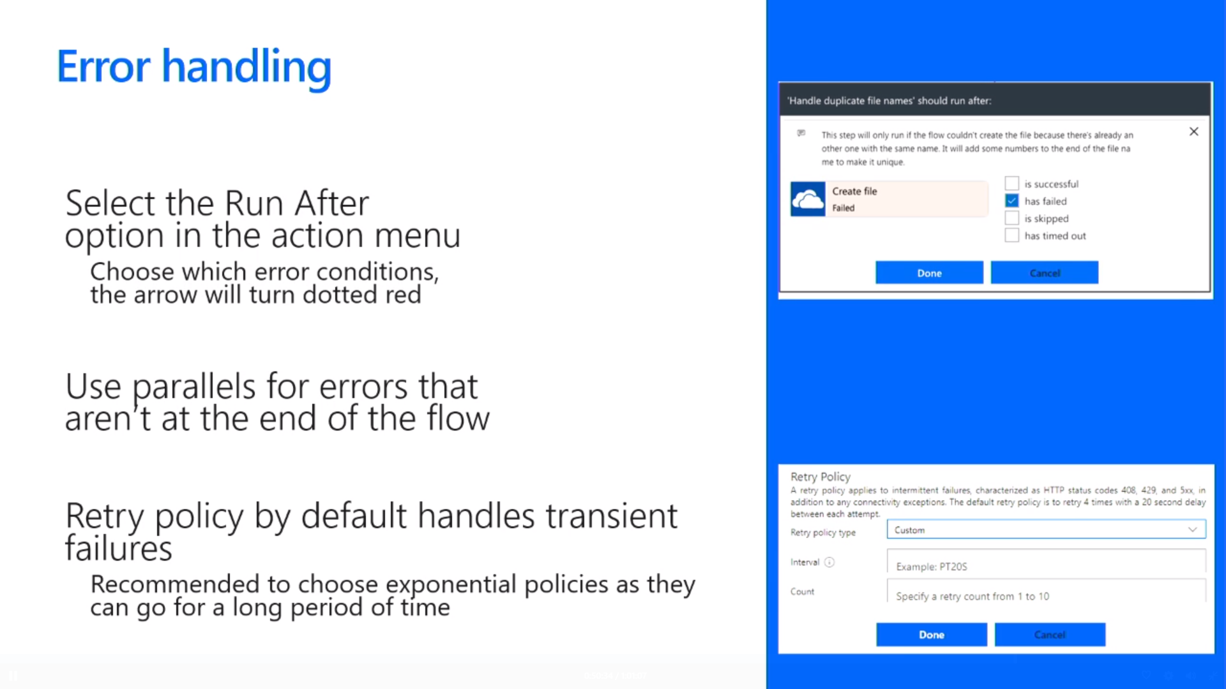
Error Handling
Select the Run after option from action menu
Choose which error conditions, the arrow will turn dotted red
Use parallels for errors that are not at end of flow
Retry policy by default handles transient failures
Recommended to select exponential as they last a long time

Slide 35
Agenda
Converting and Reshaping Data
Uploading Photos to SharePoint
Automating Approval Processes
Integrating Flow with Microsoft Forms
Handling Runtime Errors
Understanding Parallel Execution

Slide 36
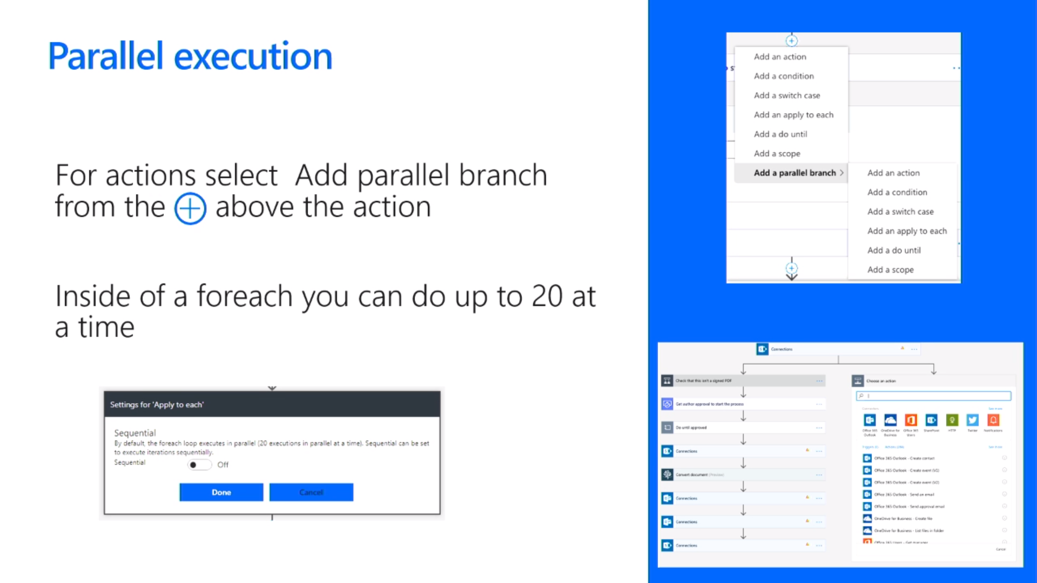
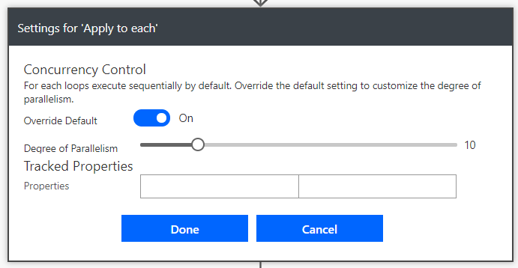
Parallel Execution
Add parallel branch from above using +
Apply to each is sequential by default
Adding parallel execute to Apply to each

Slide 37
Summary
Converting and Reshaping Data
Uploading Photos to SharePoint
Automating Approval Processes
Integrating Flow with Microsoft Forms
Handling Runtime Errors
Understanding Parallel Execution

